Slide 1
Building the Image Classifier using the Sequential API
Presenter: Ramkrishna Pudasaini (26)

Slide 2
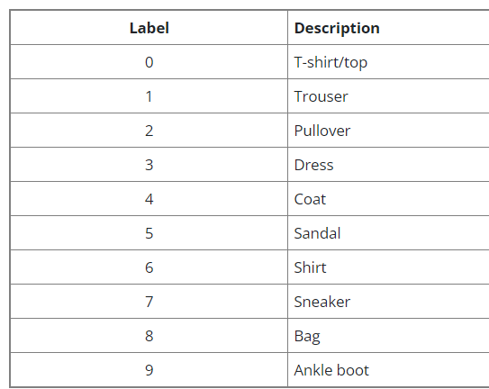
Introduction
Here we will be building an image classifier using the sequential API for the fashion MINIST dataset.
This is a dataset of 60,000 28x28
grayscale images of 10 fashion
categories, along with a test set
of 10,000 images.

Slide 3
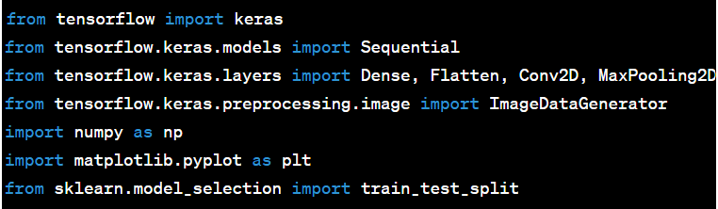
Imports

Slide 4
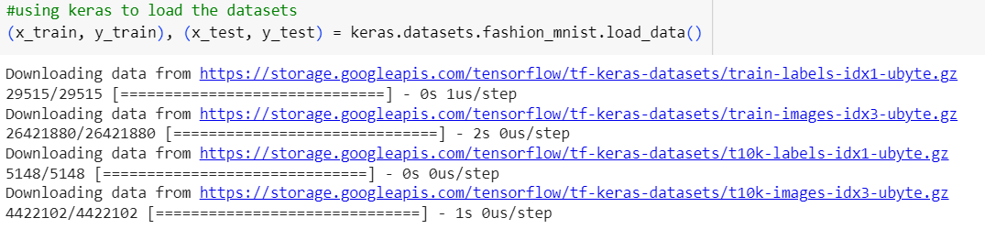

Load the data
60,000 training data images with 28 x 28

Slide 5
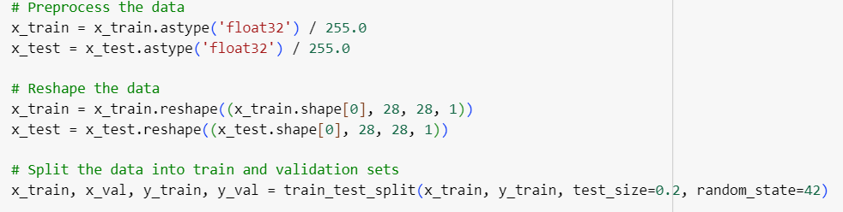
Preprocess the data
Normalizes pixel values to be between 0 and 1.
Reshapes the data to have a single channel (grayscale images).
Splits the training data into training and validation sets.

Slide 6
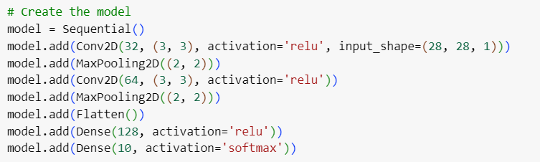
Creating the Model using the Sequential API
Create the model
Add a convolutional layer with 32 filters
Add a max-pooling layer
Add a convolutional layer with 64 filters
Add a max-pooling layer
Flatten the outputs
Add a dense (fully connected) layer with 128 units
Add the output layer with 10 units (for 10 classes) and softmax activation

Slide 7
Compiling the model
After creating the model we must call the compiler () method to specify the loss function and the optimizer to use
Adam optimization is a stochastic gradient descent method that is based on adaptive estimation of first-order and second-order moments.

Slide 8
Fit the model
Training the model using the training data, validating on the validation set for 10 epochs.

Slide 9
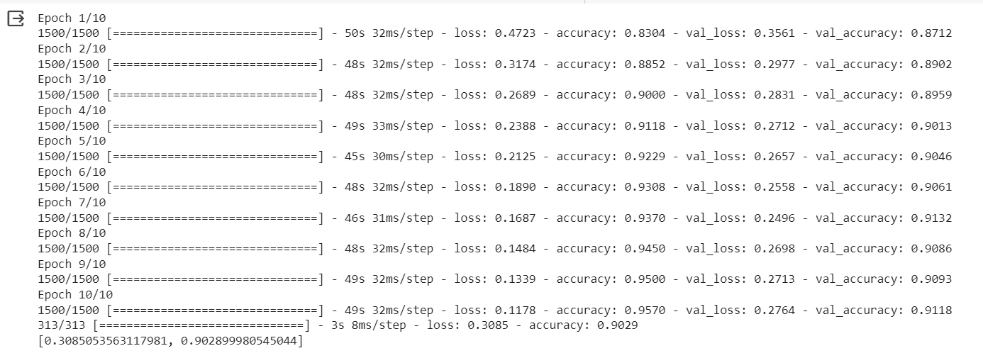
Model Training

Slide 10
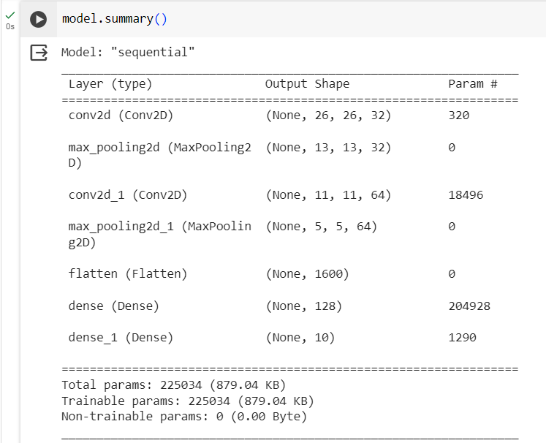
Model Summary
The Model’s Summary methods display all the Models Layers including each layers name.
The Summary ends with total parameters with trainable and untrainable parameters.

Slide 11
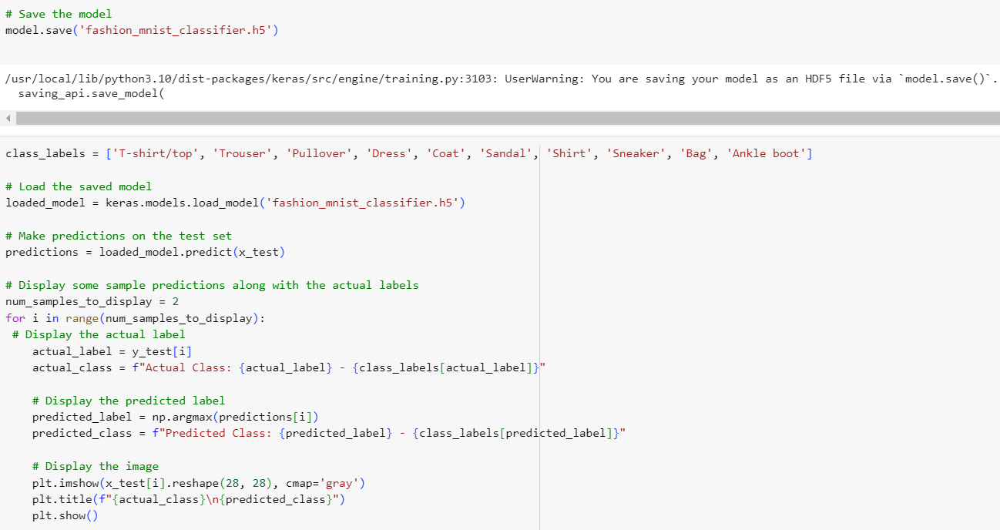
Save the model and Make Prediction

Slide 12
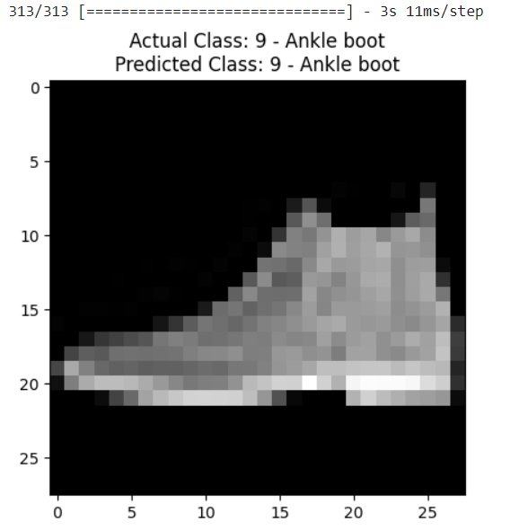
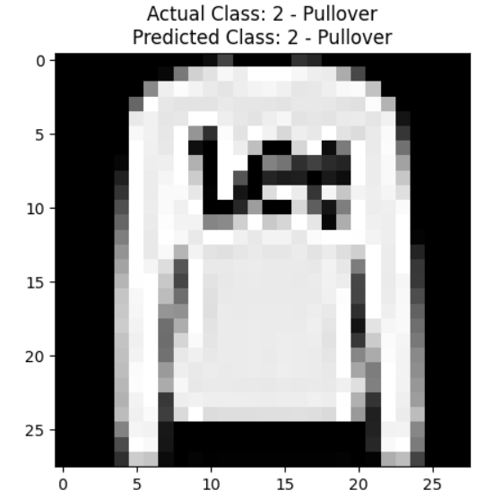
Results

Slide 13
Conclusions
In summary, the code uses Keras Sequential API to build a Convolutional Neural Network (CNN) for image classification on the Fashion MNIST dataset. It involves loading and preprocessing data, defining a CNN architecture, compiling with an optimizer, training, evaluating along with the model summary and test data predictions with results.

Slide 14
Thank You

